Slide 1



The JANET Home Service
Nicola Barsanti, Riccardo Bertini

Slide 2

What is the JANET Home Service?
A Web Service targeted to the Internet of Things (IoT) consumer market.
Remote management and monitoring of smart devices deployed in user-defined environments.
In its current release, smart environments are simulated through the use of virtual machines.

Slide 3
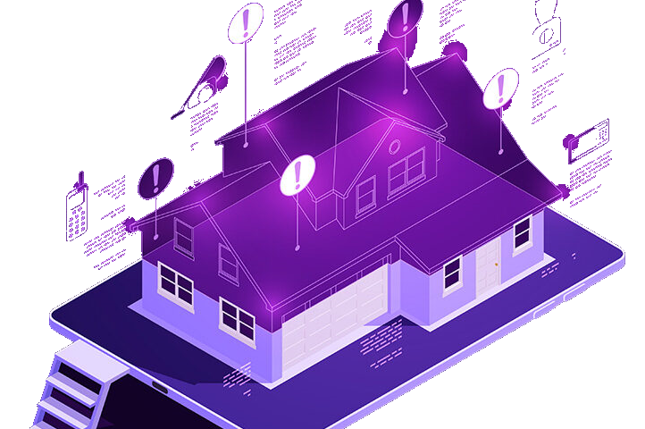
Main Concepts
Location
User-defined operating environment (LAN)
Includes a Janet Controller acting as a border gateway between smart devices and the cloud infrastructure
Sublocation
Logical partitioning (sub-environment) of a location
Device
Smart device characterized by a state comprised of traits
State may evolve autonomously
Supported devices: Fan, Light Door, Thermostat, Conditioner

Slide 4



Main Functionalities
Unauthenticated Users
Register in the application via e-mail verification
Recover lost password via e-mail
Authenticated Users
Add and delete locations, sublocations or devices
Define custom names for their locations, sublocations and devices
View the current configuration and state of their locations, sublocations and devices
Issue commands to change the state of their devices
Browse usage statistics of their devices

Slide 5

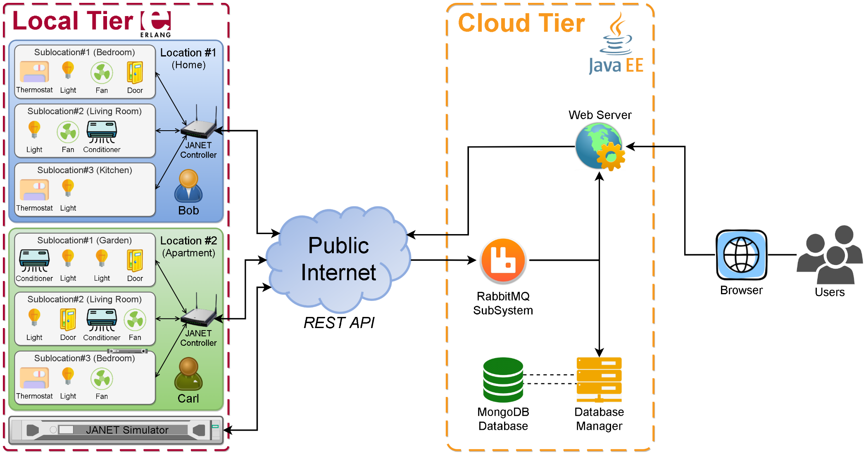
Software Architecture

Slide 6
JANEThome Application
General Structure and Concurrency

Slide 7
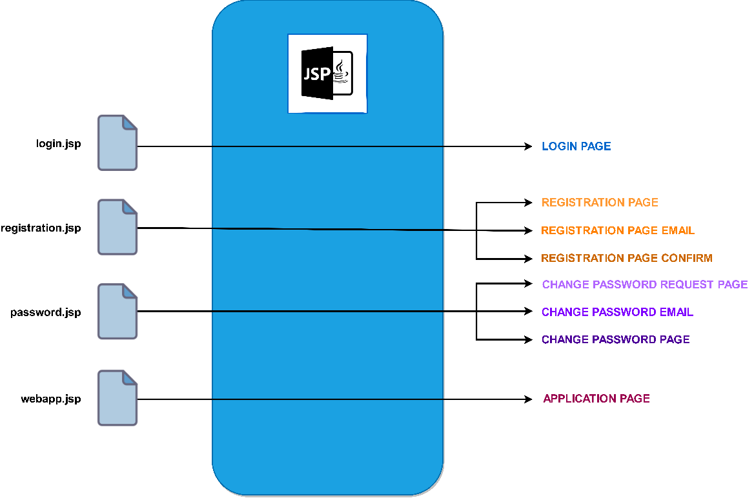
Web Application
The web server consists in a set of four jsp pages, from this by JSP compiling we derive the set of pages showed to the final users
For application page we prefer to demand the building of the page to the client. JSP will be useless due to the high mutability of the smarthome
Application page uses a webSocket to generate an asynchronous communication with the web server

Slide 8
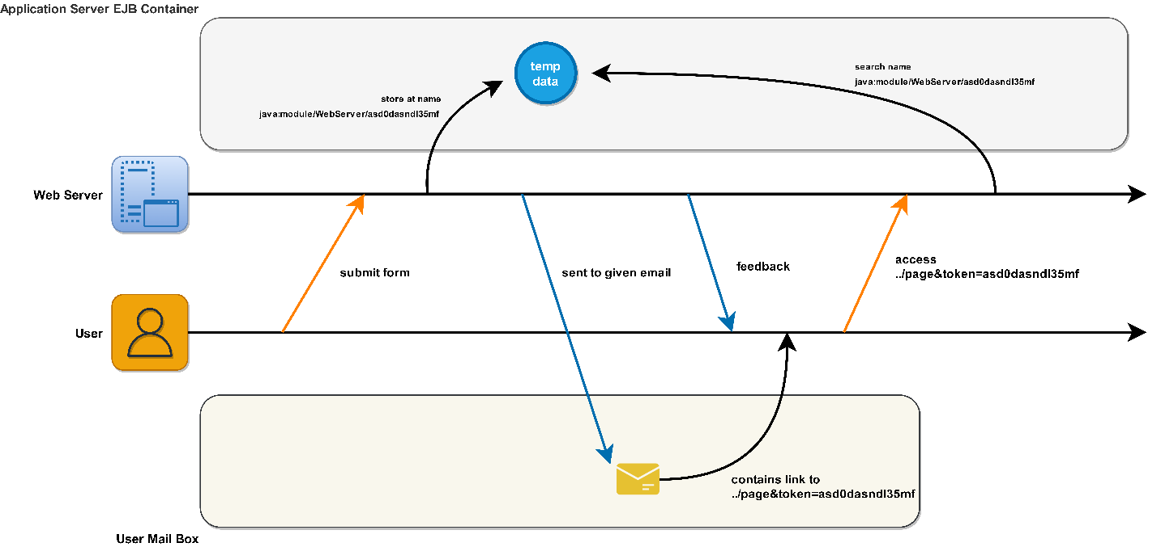
Registration & Password Change
During password change/registration we use jndi as a mechanism for storing temporary data that need to be authenticated by the user. Only the user knows the 120bit key so only the user can reach the data. Data will be automatically removed after 1 hour

Slide 9
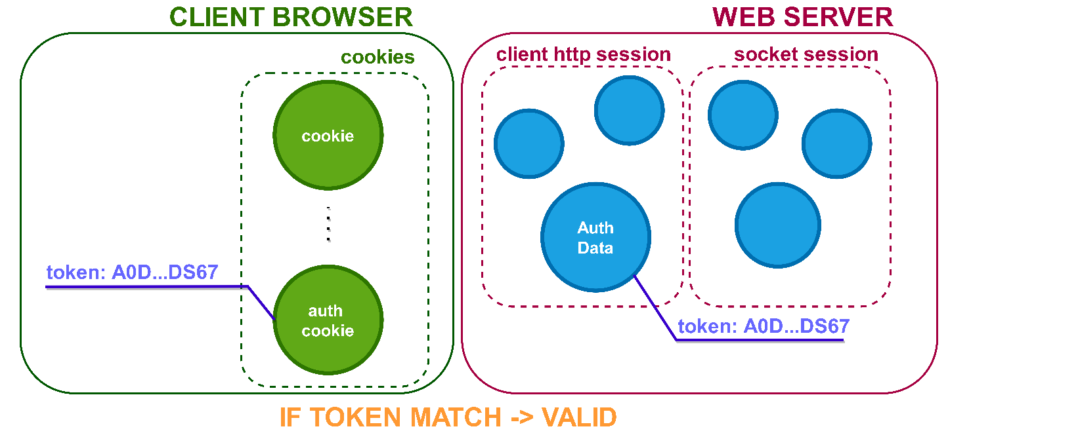
AutoLogin & Security
After a valid login the web application will store an authtoken into the httpSession and user cookies
After each operation the authToken will be updated
With authtoken stored clients can perform autologin and make requests to the service

Slide 10
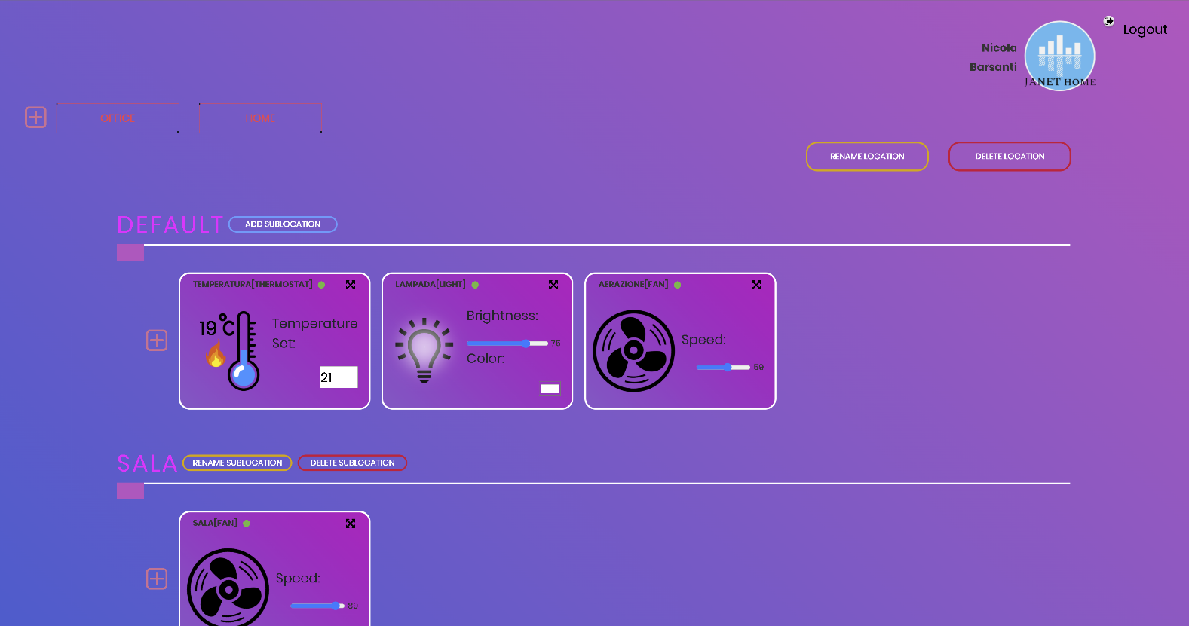
Application
LOGOUT
LOCATIONs
SUBLOCATIONs
DEVICEs

Slide 11
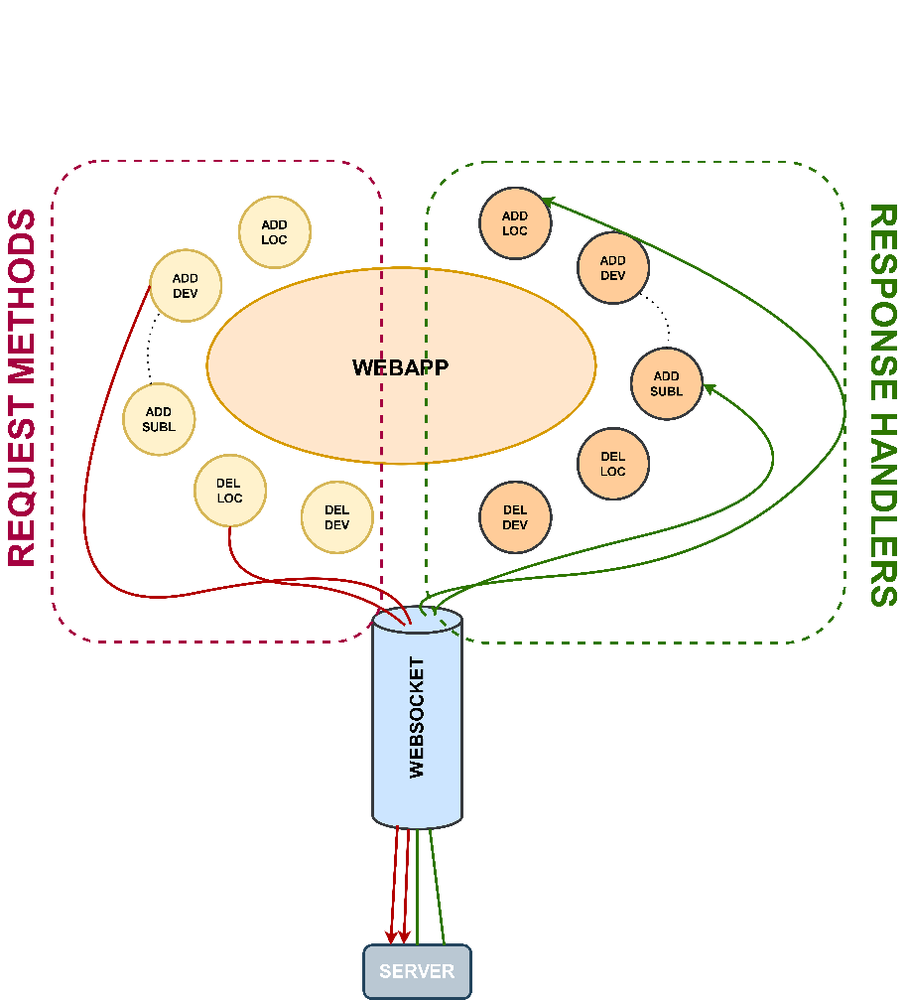
Client-Server Communications
Communications between the client and server is implented by webSocket technology
A special javascript file named connection.js handles a set of request methods and response handlers

Slide 12
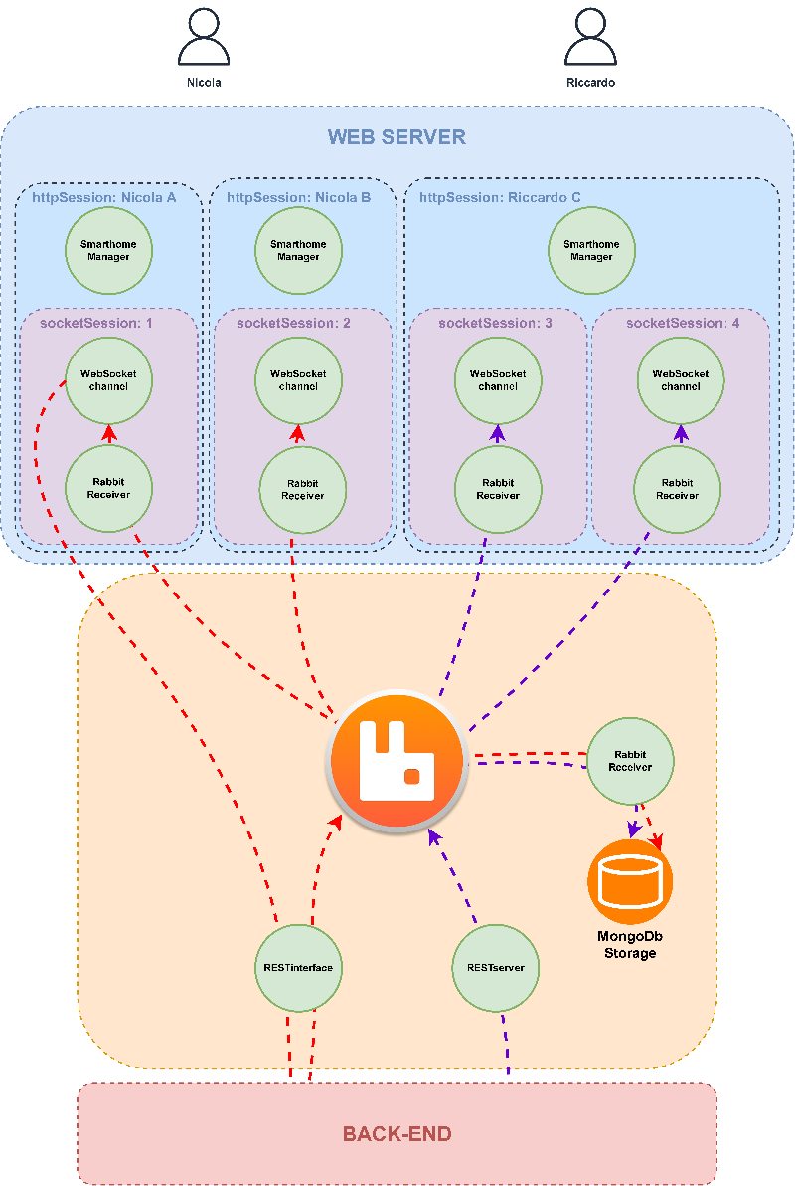
Request Flow
We have removed coordination by splitting the data management in parallel and indipendent tasks
The only elements which have to deal with coordination problem is the SmarthomeManager
Smarthome realized to manage requests with idempotency

Slide 13
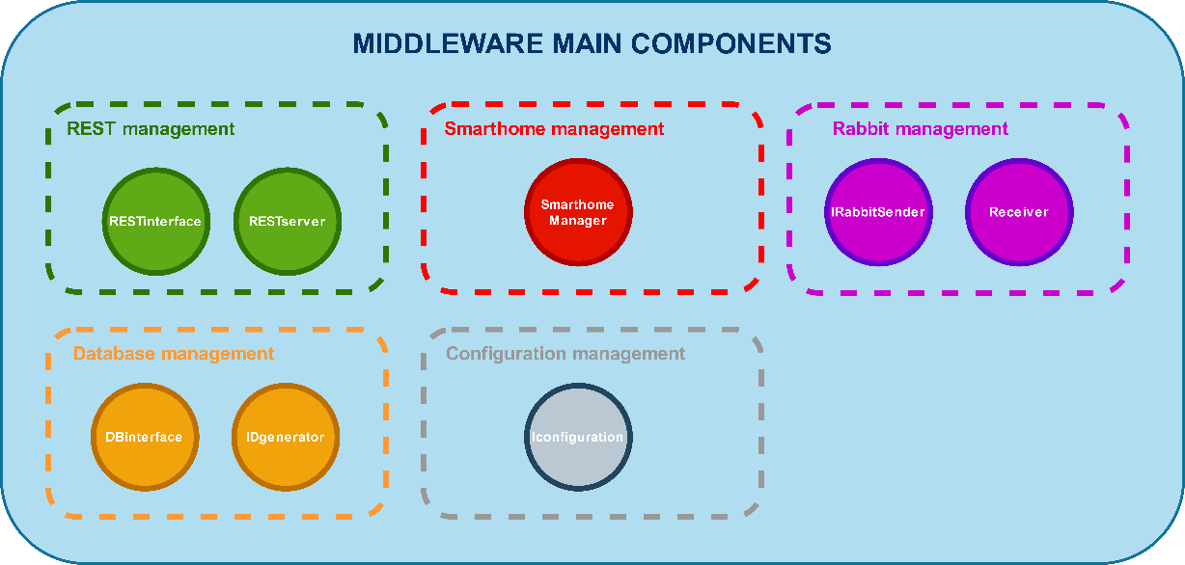
Middleware Support
Middleware provides a set of interfaces and classes for support the web application functionalities
Rest management(in/out)
Control logic(smarthome)
Internal communications
Storage persistence and data aggregation
Centralized configuration dispatcher

Slide 14

JANET Home Simulator
An Erlang smart environments simulator

Slide 15


Simulator Components
OTP Applications / Nodes
started/stopped dynamically by the simulator among any nodes host
JANET Device – smart device
JANET Controller – location controller
JANET Simulator – simulation manager
Middleware Components
Mnesia – Built-in DBMS
Cowboy – HTTP server
Ranch – TCP socket acceptor
Cowlib – Support library application
JSONE – Erlang ↔ JSON marshalling/unmarshalling

Slide 16
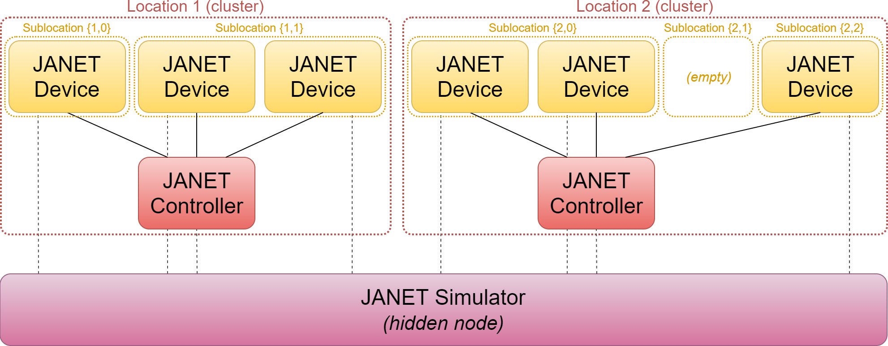
Clusters Organization

Slide 17
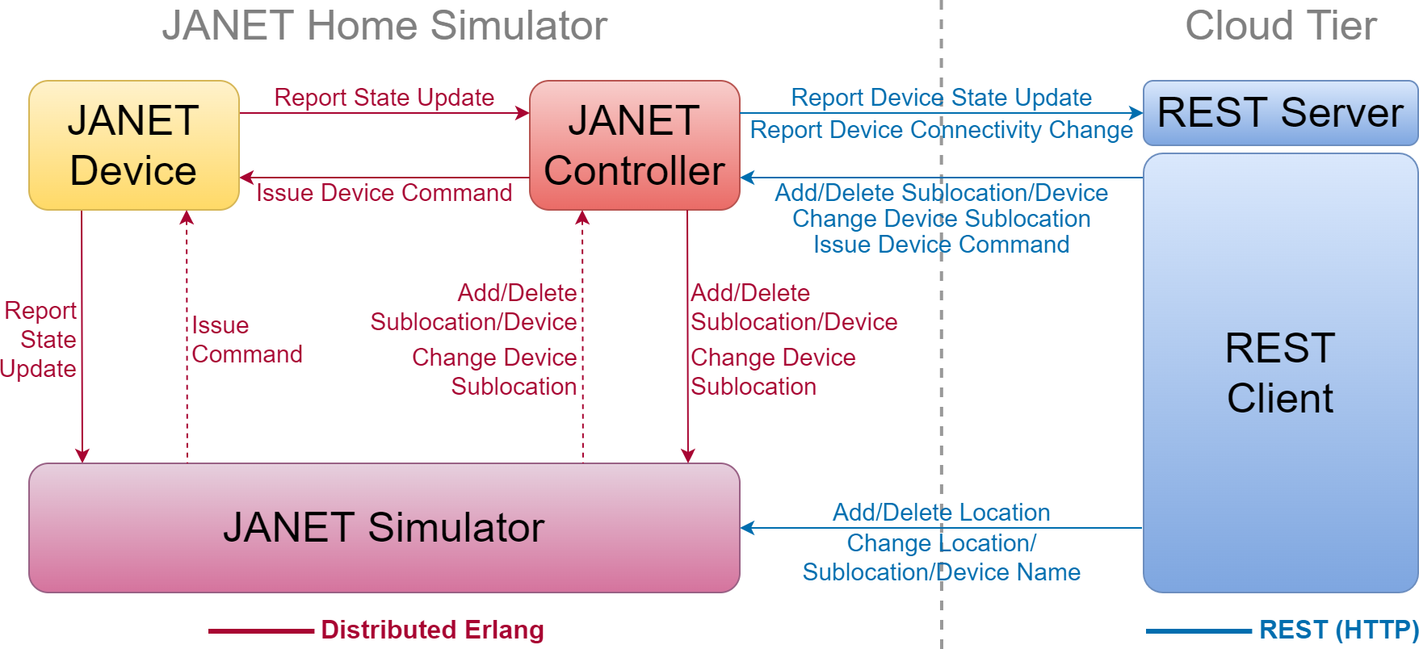
Application Dataflow

Slide 18
Simulator Start-up Sequence
Locations and devices configuration are retrieved from the simulator Mnesia database
A Manager process is created for each location and device
Managers start their associated nodes on their designated hosts and launch the appropriate OTP applications
Once started nodes register with their manager processes.
Device nodes attempt to pair with their location controller
Controller nodes accept pairing requests and attempt to establish a persistent HTTP connection with the remote REST server
The system is fully operational

Slide 19

Nodes Management
Nodes are both linked and monitored by their manager processes on the JANET Simulator, which allows for:
Their automatic restart should they stop or crash
Their automatic shutdown when their associated location or device is deleted or when the simulation environment is shut down
The possibility of dynamically stopping/restarting them for simulating conditions in which their associated physical devices are powered off or disconnected from their LANs

Slide 20

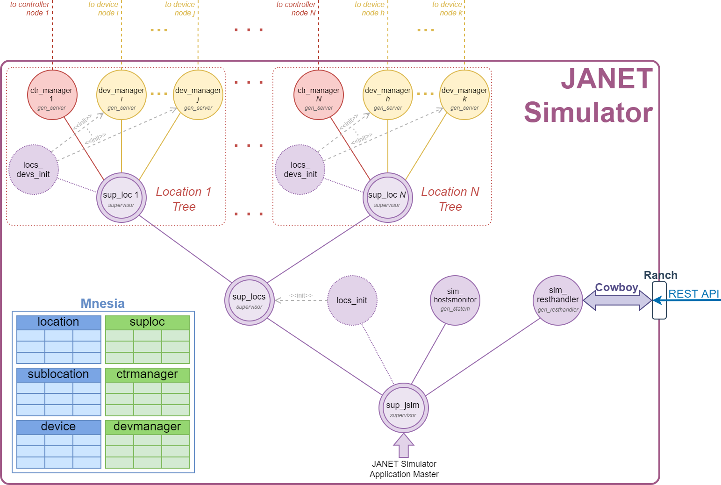

Slide 21
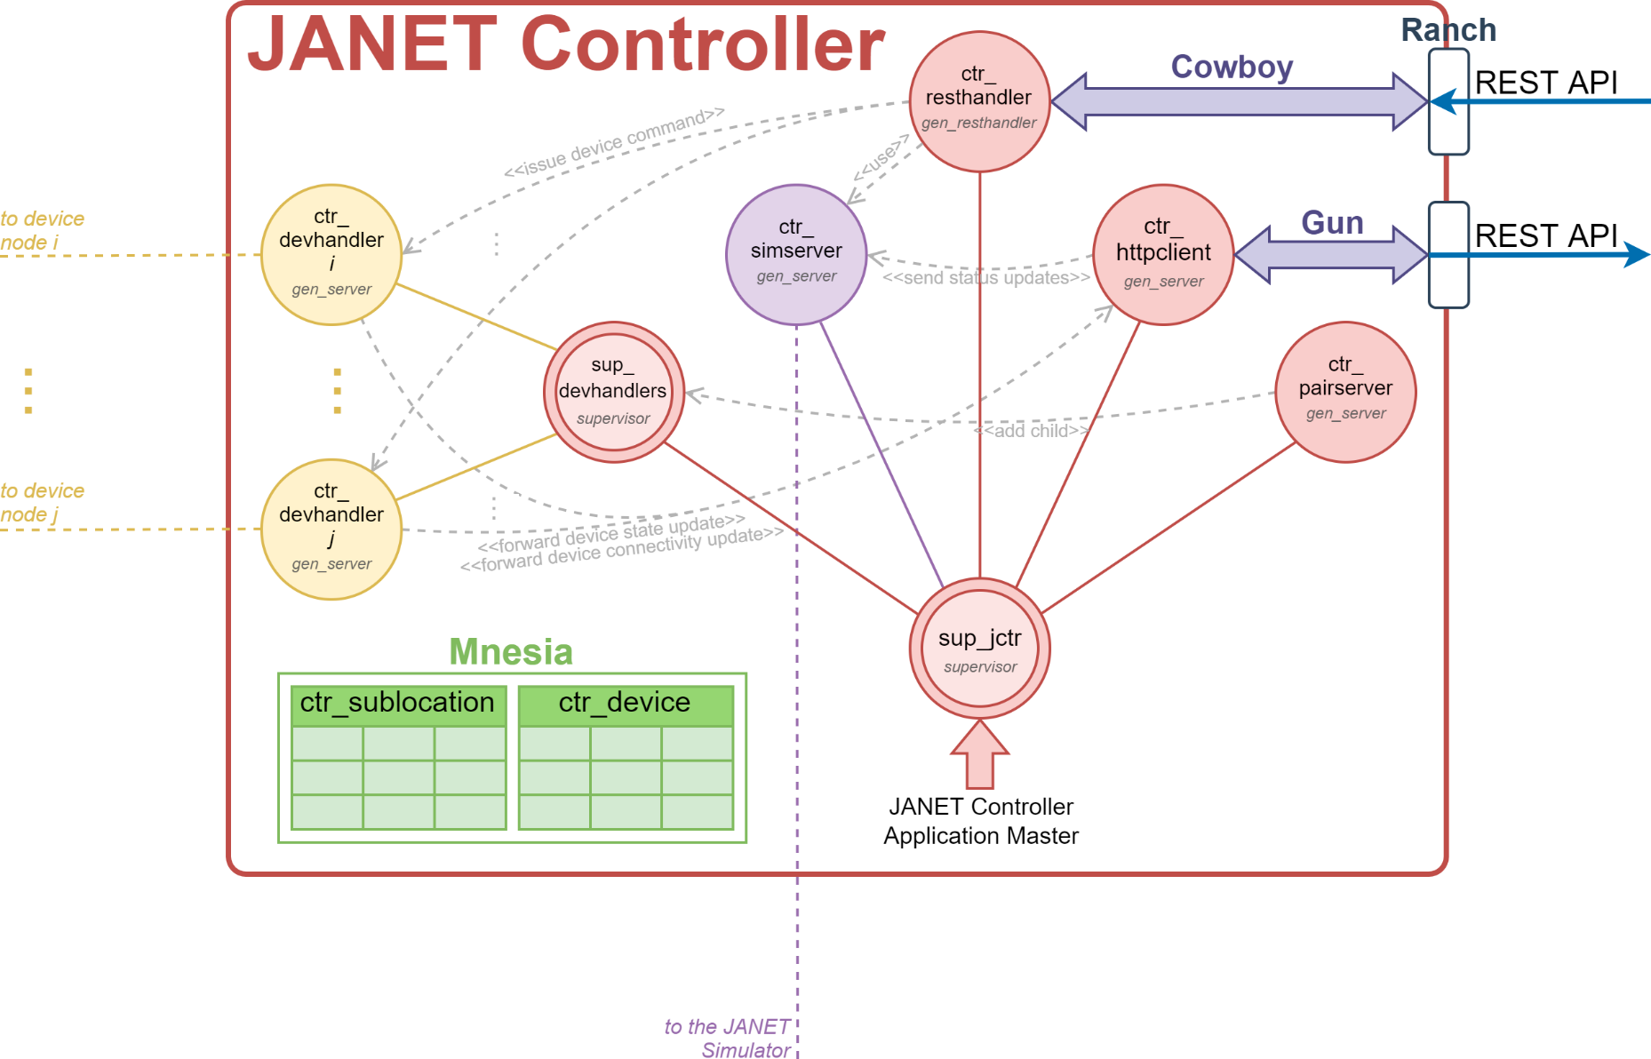

Slide 22
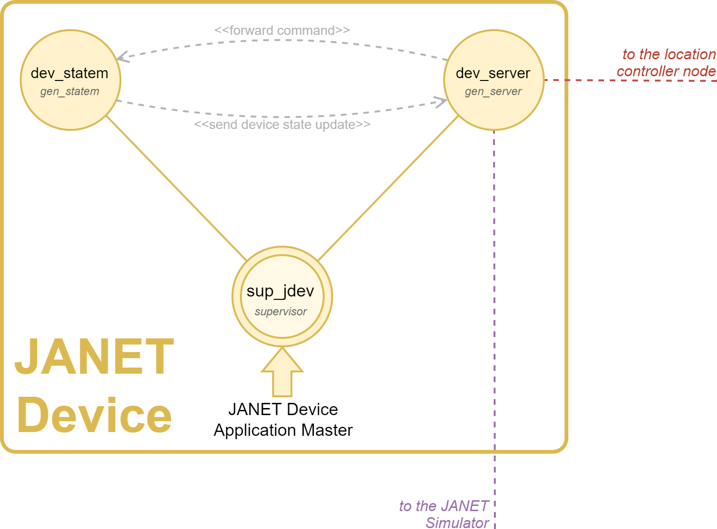

Slide 23
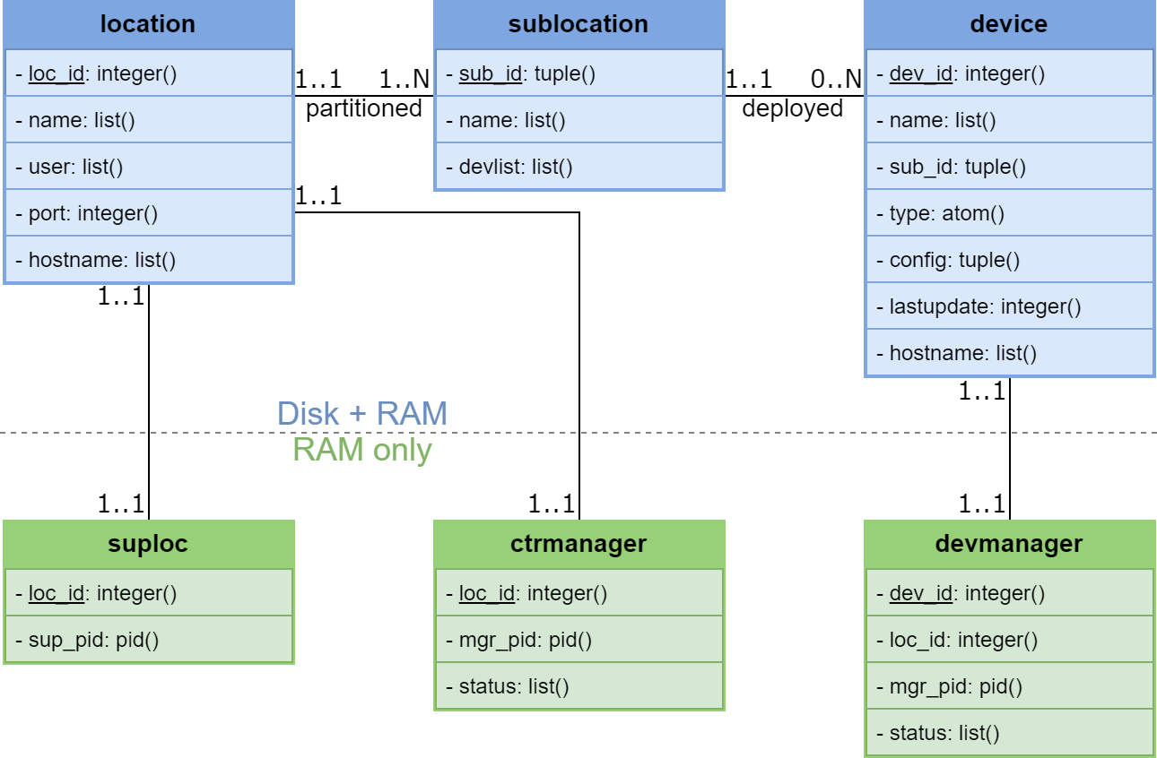
Simulation Database

Slide 24
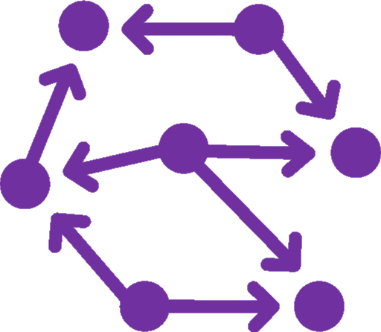

Concurrency Management
Resource Manager approach: each resource is managed by its own process
Transactions enable atomic access to the required state information
Consistency Management
Synchronization between the JANET Simulator and controller database obtained via explicit messages
In case of errors consistency is enforced by stopping and restarting nodes from the data in the JANET Simulator master database
Messages towards unavailable hosts are buffered by the senders

Slide 25
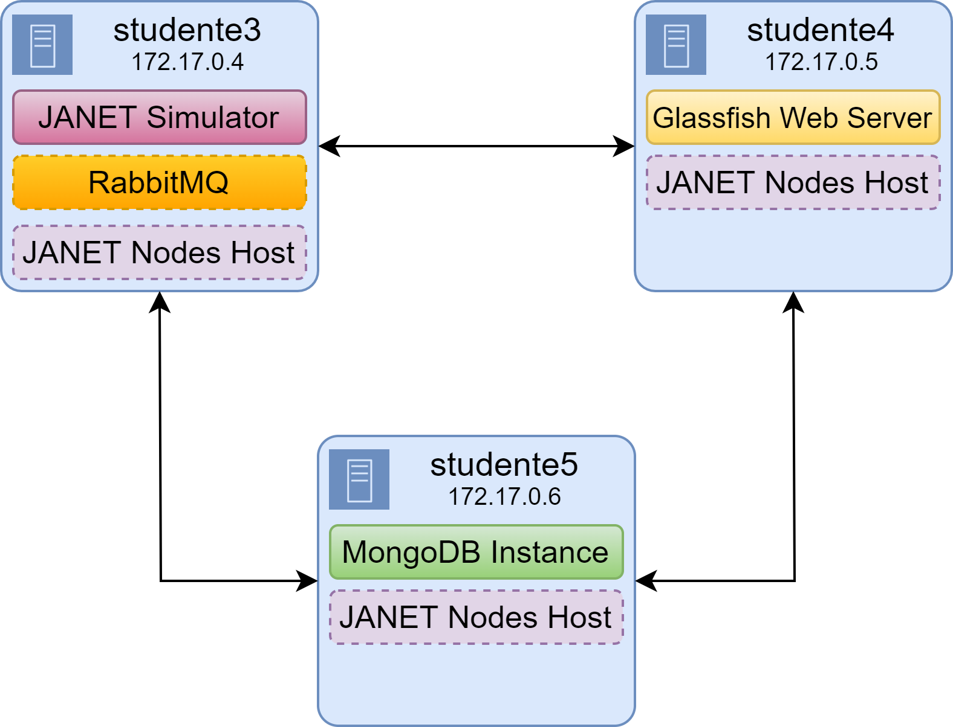
Service Deployment

Slide 26
Thank you for your attention

